Slide 1
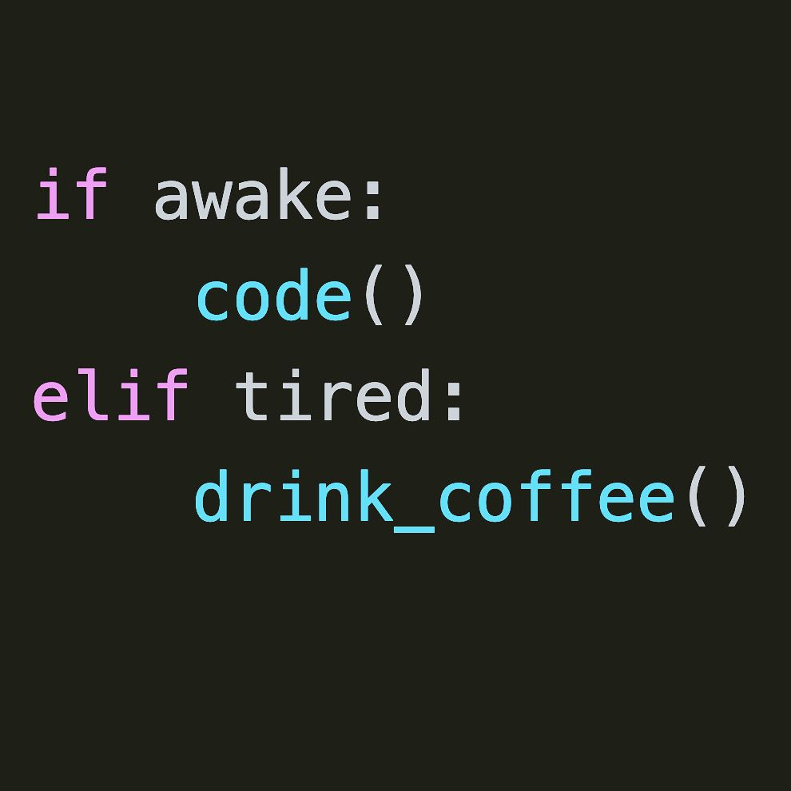
Source

Slide 2
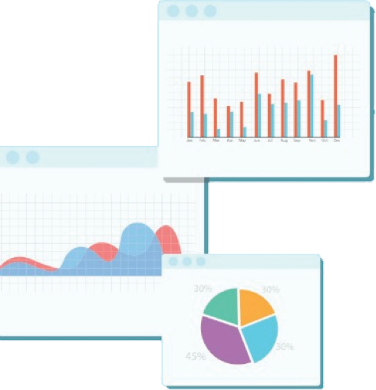

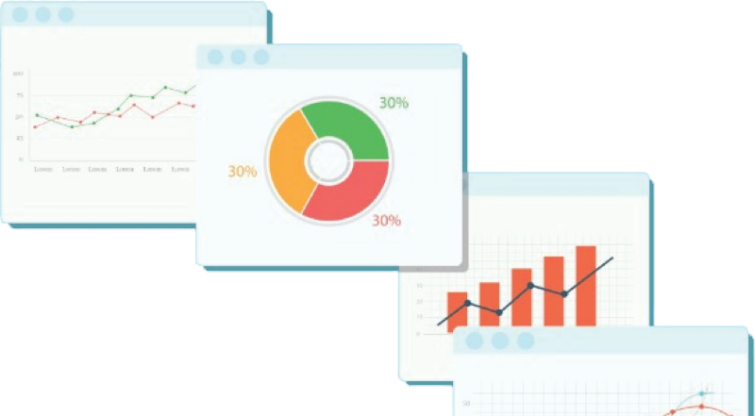
Welcome to Week 3
Lecture 1!
Data Science in Python &
Machine Learning

Slide 3
Stack 1 Belt Exam
Eligibility:
90 % of Week 1 & 2 Assignments
Including Resubmits
Due: 9 AM PST on Thursday (02/10/22)
Unlock Codes:
Thursday after Class
Must start exam by 11:59 pm Saturday
Note: You have 24 hours to Complete Exam

Slide 4
Week 3 CORE Assignments
These MUST be submitted by Sunday February 13th:
Average Height Exercise (Core)
Histograms & Boxplots (Core)
Project 1 - Part 3 (Core)

Slide 5
Learning Goals
By the end of this lesson you will be able to:
Univariate Data Visualizations
Exploratory Data Analysis
Use Matplotlib.pyplot
Create a barchart, histogram and boxplot

Slide 6
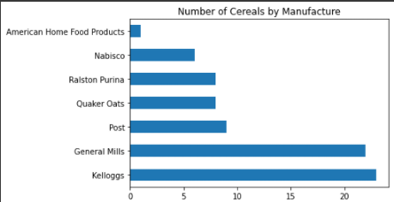
Univariate Data Visualizations
Exploring one column at a time

Slide 7
Exploratory Data Analysis
For You, the Data Scientist to Understand Your Data
(And Maybe for Technical Audiences)

Slide 8
Exploratory Data Analysis
What is your data like?
.shape
.describe()

Slide 9
Exploratory Data Analysis
What is your dataset like?
.shape
.describe()
How is data distributed?
Categorical
How many of each category?

Slide 10
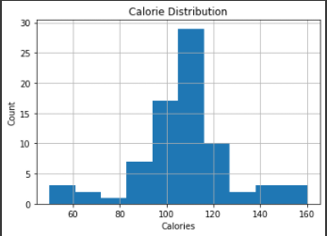
Exploratory Data Analysis
What is your dataset like?
.shape
.describe()
How is data distributed?
Categorical
How many of each category?
Numeric
What values are most of the data near?

Slide 11
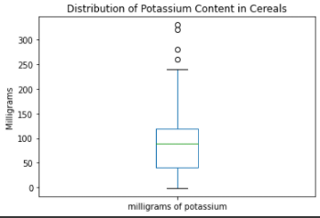
Exploratory Data Analysis
What is your dataset like?
.shape
.describe()
How is data distributed?
Categorical
How many of each category?
Numeric
What values are most of the data near?
Where are the outliers?

Slide 12

Univariate Analysis in Python
Exploring one variable at a time

Slide 13

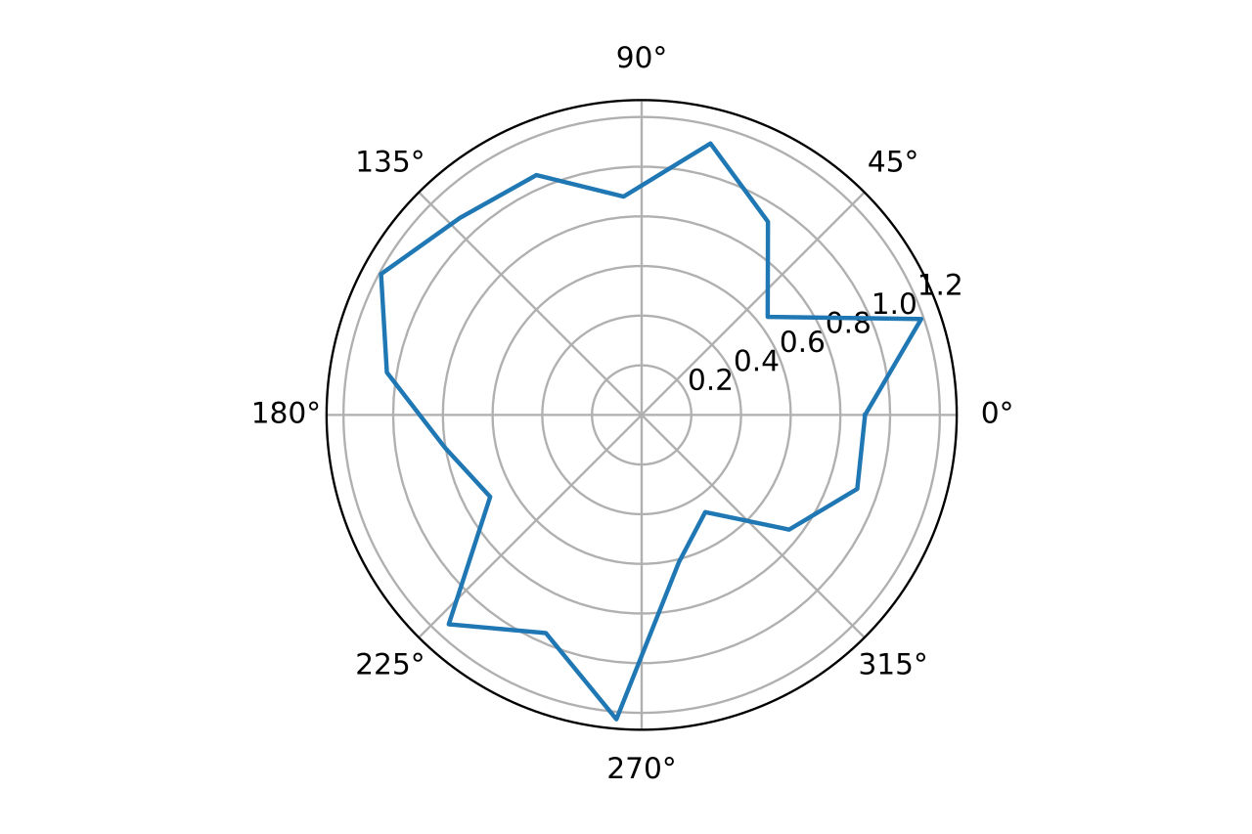
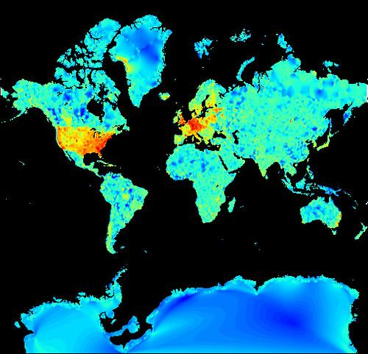
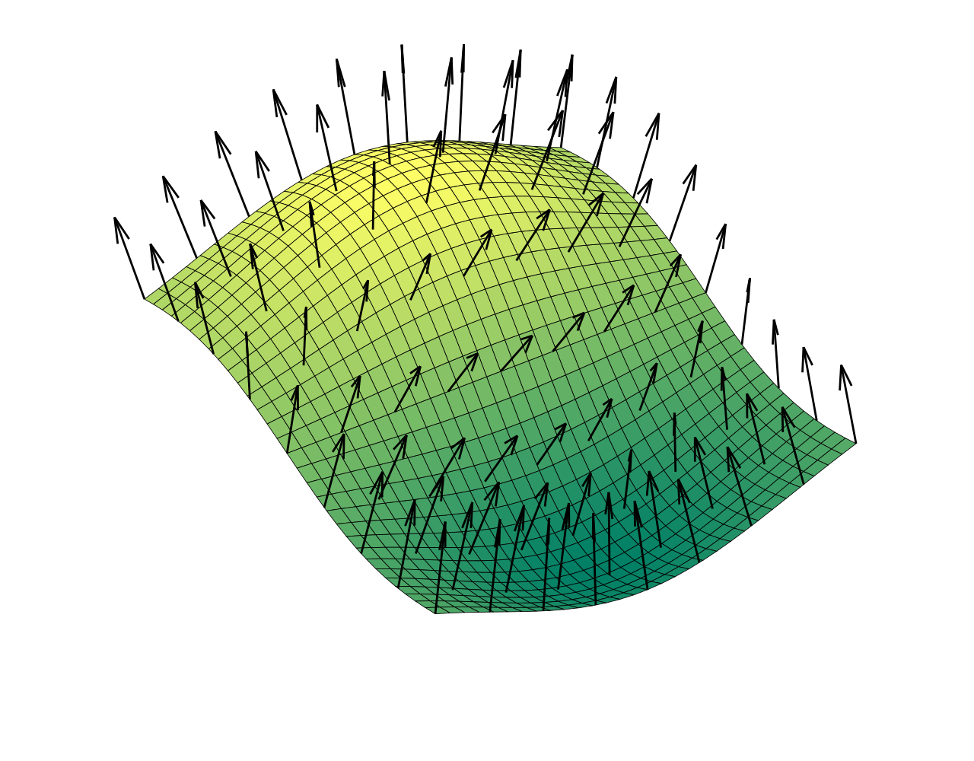
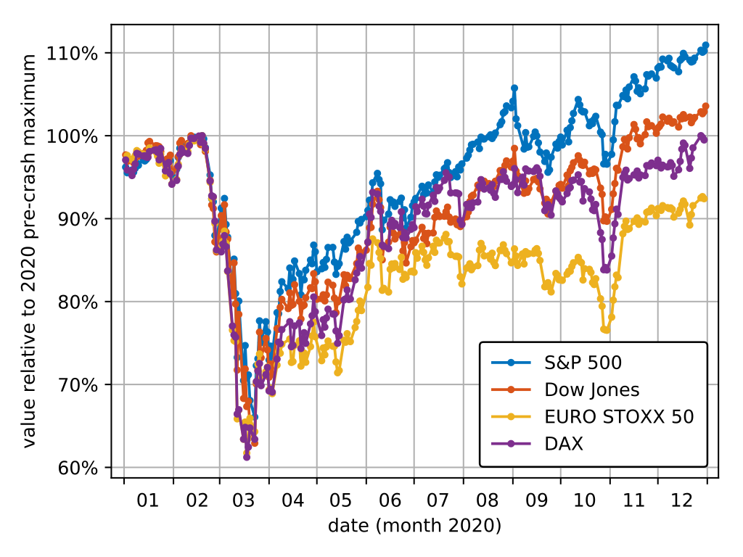

Slide 14
The Power behind the Plotting
Matplotlib.pyplot (plt)
Seaborn (sns)
Pandas Plotting

Slide 15
Sample Code!
In this sample univariate plotting notebook

Slide 16
Codealong:
Python Visualizations 101 - Part 1
I’ve saved the traditional class activity to be an optional bonus assignment to practice your data cleaning & visualization skills.
See the final slide for the link.
Instead, we will walk through how to create & customize a specific visualization in 4 different ways
Colab Notebook

Slide 17
And now for the FUN!
The one and only…
Clean and Plot
Univariate Challenge!
Optional Bonus Practice Assignment!
Also Required:
Medical Data

Slide 18
Please share your best visualization with the class on Discord!

